Slide 1
Configuration Management
W/W Development process Sharing
Dec 02, 2019
PHUONG NGUYEN
QA
Renesas Electronics Corporation

Slide 2
Agenda
Abbreviation
CM Common issue

Slide 3
Abbreviation
Short form | Full word
BM | Baseline Management
CM | Configuration Management
Config. Audit | Configuration Audit
CRM | Change (Request) Management
DM | Data Management
PIC | Person In Charge
SPO | Share Point
Trace. Manage. | Traceability Management
VM | Version Management
BAR | Bug After Release (leakage bug)
Short form | Full word
UD | Unit Design (= Detail Design in WW standard May 2018 version)
Notes:
The complexity of this question is just the same with the question “Why do need QA?”

Slide 4
Cm Common issue

Slide 5
Cm finding status rvc 2019
# | 19K | 19S
CM finding | 34 | 39
Total finding | 337 | 251
% CM finding | 10% | 16%

Slide 6
Cm finding status rvc 2019
Finding type | Jan | Feb | Mar | Apr | May | Jun | Jul | Aug | Sep | Oct | Nov | Total
FC | 2 |  | 1 | 4 | 5 | 5 | 1 | 4 | 2 | 7 | 5 | 36
NC | 8 | 3 | 2 | 2 | 4 | 3 | 4 | 4 | 2 | 4 | 1 | 37
Grand Total | 10 | 3 | 3 | 6 | 9 | 8 | 5 | 8 | 4 | 11 | 6 | 73
CM finding | Jan | Feb | Mar | Apr | May | Jun | Jul | Aug | Sep | Oct | Nov | Grand Total
Baseline creating | 3 |  | 1 | 1 |  |  | 1 | 1 | 1 | 1 | 1 | 10
CM plan | 1 | 2 |  |  | 2 | 1 | 2 | 1 |  | 1 |  | 10
CM table | 4 |  | 1 | 2 | 3 | 2 | 1 | 3 | 1 | 4 | 2 | 23
Config audit | 2 | 1 | 1 | 3 | 4 | 5 | 1 | 3 | 2 | 5 | 3 | 30
Grand Total | 5 | 3 | 3 | 6 | 9 | 8 | 5 | 8 | 4 | 11 | 6 | 73

Slide 7
Cm finding status rvc 2019 - cm major issue
Config. Audit has been marked the highest QA finding amount in 2019.
Baseline creating is a small step in Baseline Management but got a significant amount of finding.
CM table is the work product which has got a certain high finding amount in 2019.
CM plan’s total finding is in normal range.
Config. audit
High CM findings
Baseline creating
CM table

Slide 8
Cm major issue 1

Slide 9
Cm major issue 1 Config. Audit. finding
Total: 26 over 65 CM findings.
Incorrect Config. Audit plan 8 Cause 1
Config. audit
No Config. Audit at required time 12 Cause 2
Incorrect Config. Audit 10 Cause 3
High CM findings
Baseline creating
CM table

Slide 10
Cm major issue 1 Config. Audit. finding – cause 1
Cause 1. Incorrect config. audit plan:
Issue description
Only data management has been implemented. Configuration audit is lacking much, no plan, no items defined.
The release milestone is coming and there's no plan for audit the outputs before DR and the release.
Baseline establishment and configuration plan is not defined in project plan. Beside that, the configuration method defined in project plan is not appropriate.
Config. audit plan is not updated as DR plan changed.
Master schedule and Config. audit plan in Project plan are not up-to-dated as Project new schedule due to Beta delay.
Config. audit date is not re-plan as latest Master schedule while the schedule is deviated for 1 month, more than 10% threshold as PP/ Criteria of deviations defined.
No re-plan RD Baseline establishment and Re-config for RD in Config audit plan.
No CD configuration audit implemented for the code change. This Code change is out of plan but PL, PM should inform the Config. auditor to check or define new method of Config. audit for sudden change
Please read JB5001_011_CM_20191118.ppt in Appendix slide
Root cause 1: Schedule change
Root cause 2: Process change

Slide 11
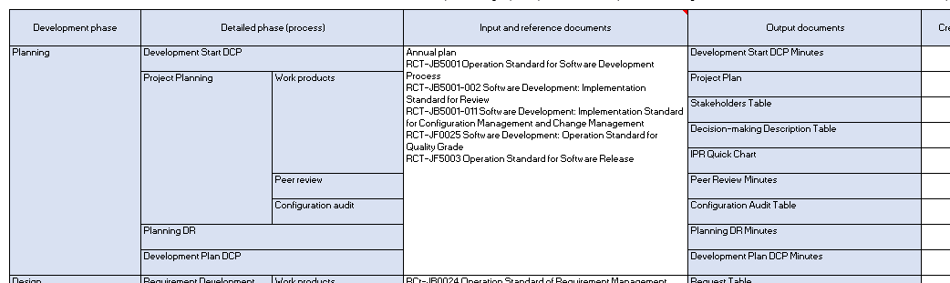
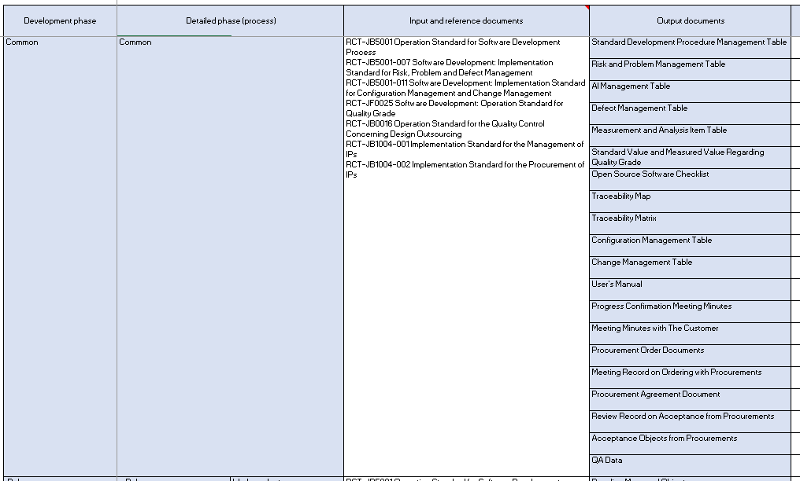
Cm major issue 1 Config. Audit. finding – cause 1
Cause 1. Incorrect config. audit plan
Root cause 1: Schedule change
Project schedule frequently changes because of delay or new change request. Project schedule, DR plan are updated but Baseline plan and Config. Audit plan is not.
Solution:
1.1. If the change schedule meets the required condition in JB5001/ section 10. Change and Cancellation of the project plan, a set of PP work products need to be updated.
Project can use SDPMT to check all needed PP work products.

Slide 12
Cm major issue 1 Config. Audit. finding – cause 1
Cause 1. Incorrect config. audit plan
Root cause 1 - Solution:
1.2. If the changed schedule is not over Criteria of deviations in PP, new plan of Config. audit date should be considered in Weekly progress meeting minutes as JB5001/ section 16.2.3. Progress management policy defines:
“The project leader periodically holds a progress confirmation meeting to confirm the progress of the development planning, and the development and management activities required to achieve the objectives of the project plan.”

Slide 13
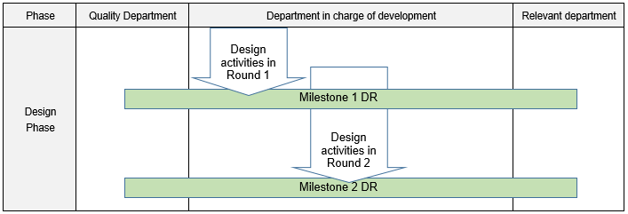
Cm major issue 1 Config. Audit. finding – cause 1
PP, RD, CD, Testing phase 1
Testing phase 2 + CD/RD updated
Cause 1. Incorrect config. audit plan
Root cause 2: Process change
At DR for Milestone, no CD/ RD config. audit provided for the change. Project only planned to do Config. Audit for Testing.
Solution:
Bug from Test, PR defect always happen and can impact to previous completed work product. No plan can provided ahead for such cases from the project starting time but it can be defined during Weekly progress monitoring or at baseline time.
To CM PIC, the different information between 2 baseline IDs should be described:
Source of change: Requirement/ Bug from Test/ PR minutes/ Change request/ DR minutes.
Which processes: CD, UT, IT,…
If an additional baseline object occurs, it should be notified Config. auditor earlier.

Slide 14
Cm major issue 1 Config. Audit. finding – cause 1
Cause 1. Incorrect config. audit plan
Root cause 2 - Solution:
UT Task 1
UT Task 2
Bug #1: CD, UT
UT Task 3
UT PR Defect #1: CD, UT
Version Management folder
Baseline Management folder
Milestone 1
Milestone 2
When establishing baseline, CM PIC sends the different information between 2 baseline IDs to Related stakeholders, included Config. Auditor.

Slide 15
Cm major issue 1 Config. Audit. finding – cause 2
Cause 2. No Config. Audit at required time
Solution:
To CM PIC:
Should use Tool to remind the Baseline time in Project plan.
Outlook's Task Reminder or Calendar event
Should send Baseline ID to Config. Auditor at required time to remind Config. auditor.
To Config. auditor:
Should know the schedule in Project plan by heart or by using Tool reminder
If the project is not ready to do Config. Audit at planned schedule, Config. Auditor should record the re-planned date in CM table.

Slide 16
Cm major issue 1 Config. Audit. finding – cause 3
Cause 3. Incorrect config. audit:
Issue description
There is no evidence to prove that Configuration Audit for Project Planning was performed.
The Audit activity was not well implemented. Some recorded information after the audit was not corrected or not enough information (CD/IT/ST).
Each time, config audit implemented but its result has not been separately and correctly recorded.
The CM audit activity was not well implemented.
The CM audit activity was not well implemented for work products.
Baseline to be audited was not recorded.
The audit was not well implemented. (There’s no test result of #23525. Status of architecture design was not clear and many comments have not been resolved.)
CM audit activity was not well implemented. Lacked some design documents in Initial Document checklist but it was not recognized after implementing CM audit.
STP baseline to be audited is not matched with actual one.
CM audit has not been performed for test results/baseline from combination test before DR.
Evidence like Config. Auditor’s confirmation email, commit log on SVN,… should be kept.
Should read Config audit method.xlsx in Appendix slide

Slide 17
Cm major issue 1 Config. Audit. finding – cause 3
Cause 3. Incorrect config. audit
Solution:
To Config. Auditor, there are 2 checkpoints in Config. Audit table:
“Whether all necessary changes, additions, and deletion have been implemented during the period from the preceding baseline to the current baseline”
“Whether unnecessary changes, additions, and deletion have been implemented by mistake during the period from the preceding baseline to the current baseline”
-> To detect necessary or unnecessary change:
Config. Auditor not only check the baseline establishment information from CM PIC but also verify Requirement table, Defect table, PR minutes, Change request table, DR minutes in Project reality to identify which processes should be audited.

Slide 18
Cm major issue 2

Slide 19
Cm major issue 2 Baseline creating
Total: 10 over 73 CM findings
Config. audit
High CM findings
Baseline creating
CM table

Slide 20
Cm major issue 2 Baseline creating
Issue description
First baseline of FD/DD/CD haven't been made as defined plan (at the PPQA checking time)
. 1. The baseline for WPs of UTP/UT/ITP/IT processes haven't been made. . 2. UT/IT Test reports of some modules & peer review minutes haven't been approved. . 3. Uncovered-list files haven't been approved.
The baseline in SDPMT for each WP related to configuration management has not been recorded.
Result for baseline of v7.5 and 7.6 is missing.
There were some changes on UT/IT work products, but there is no baselines set in CM table for UT/IT baselines for/before DR.
Baseline made for Project planning documents was not recorded.
The initial baseline for Project planning document is not made as planned.
Initial baseline for DD hasn't been recorded/made (as defined baseline definition in CM plan)
Initial baseline for CD hasn't been recorded/made as defined baseline definition in CM plan
There is no baselines made for UT & IT/test environment, test program which was ported from Linux to Android.
Cause 1: Baseline is not creating at required time.
Cause 2: The information of Baseline is not recorded or recorded not enough.

Slide 21
Cm major issue 2 Baseline creating – cause 1
Cause 1. Baseline is not creating at required time.
Solution:
(Go to next page)

Slide 22
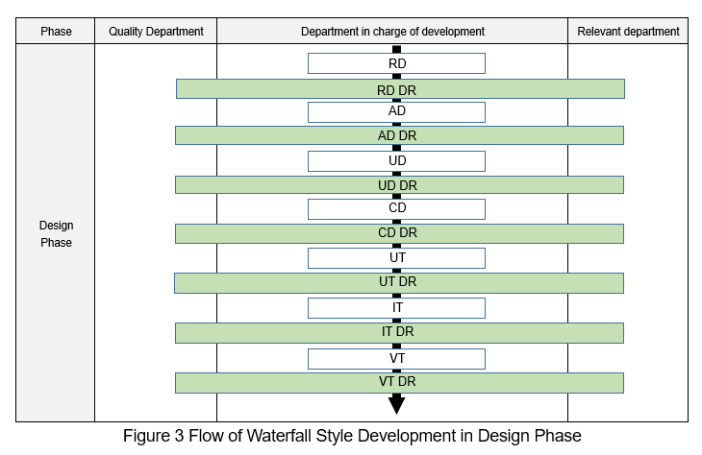
Cm major issue 2 Baseline creating – cause 1
Baseline timing
Baseline timing
required Config. audit
Design Department
Alpha release review
Beta release review

Slide 23
Cm major issue 2 Baseline creating – cause 2
Cause 2. The information of Baseline is not recorded or recorded not enough.
Solution:
(Go to next page)

Slide 24
Cm major issue 2 Baseline creating – cause 2
Baseline Management
Store a set of objects to the defined place
The storage version should link to the related requirements/ process/ milestone/ sprints/ findings
The storage duration should not >3 months
Baseline ID should be agreed by related stakeholders
Baseline ID should be sent to Config. Auditor

Slide 25
Cm major issue 2 Baseline creating
Cause 2. The information of Baseline is not recorded or recorded not enough.
Solution:
Current way: Creating a document to record all Baseline objects’ Revision ID.
Suggestion way: Creating 3 main folders
Version Management
Data Management
Baseline Management: to store a set of work product at “each break”

Slide 26
Cm major issue 2 Baseline creating
Progress Management
Version Management
folder
Data Management folder
Baseline Management folder
RD
PP
Client input
PP
1st Baseline
2nd Baseline
n Baseline
Task
RD
…
Meeting minutes
RD
…
Finding
AD
VT
PR minutes
AD
VT
CR
UD
IT
DR minutes
UD
IT
Bug from Test
CD
UT
…
CD
UT

Slide 27
Cm major issue 2 Baseline creating – cause 2
Baseline Management
Store a set of objects to the defined place
Store all work products of all processes from Version Management folder to Baseline Management folder at each Baseline time
The storage version should link to the related requirements/ process/ milestone/ sprints/ findings
In the commit log, Source of change: Requirement/ Bug from Test/ PR minutes/ Change request/ DR minutes should be described
The storage duration should not >3 months
Baseline timing in Project plan should be checked frequently with Project schedule
Baseline ID should be agreed by related stakeholders
CM PIC send Baseline ID by email to all stakeholders, included Config. auditor
Baseline ID should be sent to Config. Auditor

Slide 28
Cm major issue 3

Slide 29
Cm major issue 3 CM table
CM table finding:
Root cause | Baseline ID | BM, VM, DM | CM object | Data management | SVN structure | Version management | Grand Total
CM table | 3 | 4 | 2 | 1 | 4 | 9 | 23

Slide 30
Cm major issue 3 CM table
Cause: Version management
Issue description
WPs have not been put on defined location (as WP_Appendix list).
Version management of Test result are not implemented as Project CM plan and CM standard defined
Detailed Plan is not stored with latest version into defined location
IT contents are not the latest at the time of auditing.
PP DR checklist has not been provided in Project SVN
Many tickets haven’t been added to Initial Document List
CM management/ Implementation result is not updated for other CM objects like Test spec, test result, Test script.
Incorrect revision provided for CD output in Task ticket.
Project Plan (which was reviewed in a preivous DR): At the time of auditing, it was not "approved" & "authorized" by Manager.
Root Cause: Version Management method defined in CM table is not linked to Project reality progress working.
Team member is working in another location and does not aware what PL defined in Project plan, CM table.
Human mistake

Slide 31
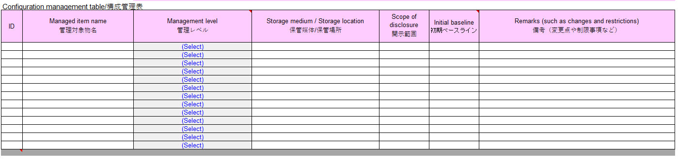
Cm major issue 3 CM table
Cause: Version management
Root cause:
Some projects only use CM table, SDPMT to define Project storage place, CM objects.
In actual working, team members are working mainly on another location and use Redmine to monitor Task status.

Slide 32
Cm major issue 3 CM table
Cause: Version management
Solution:
SDPMT can be used to plan Baseline object at each Milestone.
CM table can be used to plan Data Management object, Version Management object, Baseline Management object.
But the Storage structure should be clearly defined as Project actual working in a separated document such as SVNstructure_Small scope project.xlsx in Appendix slide.
Version management place should be the actual working place of Team member with Committing time defined to Daily or Weekly or After Peer review.

Slide 33
Appendix

Slide 34
Q&A

Slide 35
Revision history
No | Date | Description | Updated by
0.1 | Dec 02, 2019 | Init the file | Phuong Nguyen QA
0.2 | Dec 30, 2019 | Update Appendix’s embedded files, Baseline creating picture as Project reviewers’ comment | Phuong Nguyen QA, Phong Nguyen PL, Hoang Bui SE
Notes:
The complexity of this question is just the same with the question “Why do need QA?”

Slide 36
Renesas.com

